Slide 1
A Look at Higher Education - from the Outside
July 22, 2013

Slide 2
Introductions
Tim Mould, MA, MBA
Connection to Texas higher education…

Slide 3
A Look at Higher Education – from the Outside

Slide 4
Higher Education is changing…
Notes:
1. Actual email marketing message received this week. .

Slide 5
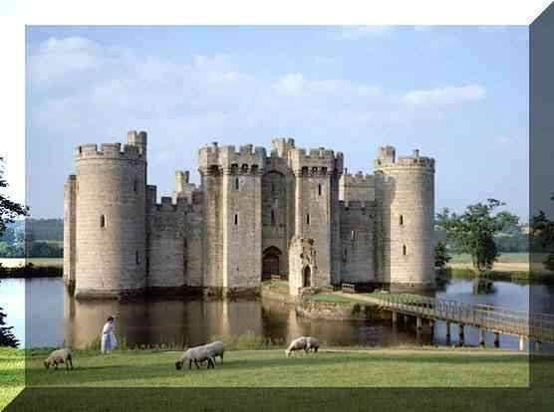
…or is it?
“Stemming from the medieval university, the overarching mission of university administration is…”¹
Notes:
1. From a recent report on transforming university administration .

Slide 6
A hypothesis…
Hypothesis: American higher education is at an inflection point – a time of tremendous change
Critical question 1: There are a number of trends impacting American higher education that will bring about change.
True?
False?
Critical question 2: If true, how will we deal with this change?
Hunker down – it will blow over
Study it
Pilot
Innovate and transform
Notes:
What do we do?
Let’s look at 8 trends impacting American higher education
Let’s ask ourselves the question, “What do we do about it?”
Hunker down – it will blow over
Study it
Pilot
Innovate and transform

Slide 7
8 Trends Impacting Higher Education²
Resources – What goes down must come up?
Costs – Shifting sands.
Faculty – To be or not to be…tenured. That is the question.
Students – Rethinking the “traditional” student.
Value – The Value Gap.
Tuition – Differential equations and other challenges.
Competition – Not all competition is on the court or gridiron.
Technology – The point is MOOC – or is it?

Slide 8
1. Resources – What goes down must come up?
Change in State Higher Education Appropriations, Enrollment, and Appropriations Per-Student, 2007-08 School Year to 2012-13 School Year
 | 2007 - 2008 | 2012 - 2013 | Change | Percent Change
State Appropriations for Higher Education | $87,172,406,161 | $70,361,814,675 | ($16,810,591,486) | -19.3%
Full-time Equivalent Enrollment at Public Colleges and Universities | 10,271,685 | 11,471,488 | 1,199,803 | 11.7%
State Appropriations Per Full Time Enrolled Student | 8,487 | 6,134 | (2,353) | -27.7%
Sources: Education appropriations data comes from the Grapevine survey conducted by Illinois State University, enrollment data comes from the State Higher Education Executive Officers’ Association. Since enrollment data is only available through the 2011-2012 school years, enrollment data for 2012-13 is an estimate based on data from past years. Dollar figures adjusted for inflation using the consumer price index.
Source:
Phil Oliff, Vincent Palacios, Ingrid Johnson, and Michael Leachman. “Recent Deep State Higher Education Cuts May Harm Students and the Economy for Years to Come.” Center on Budget and Policy Priorities, March 19, 2013: 21.

Slide 9
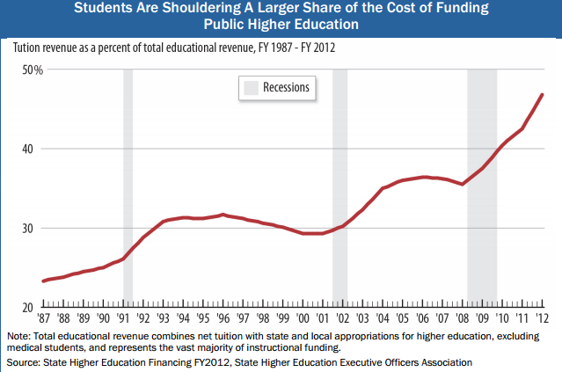
1. Resources – What goes down must come up?
Source:
Phil Oliff, Vincent Palacios, Ingrid Johnson, and Michael Leachman. “Recent Deep State Higher Education Cuts May Harm Students and the Economy for Years to Come.” Center on Budget and Policy Priorities, March 19, 2013: 13.

Slide 10
2. Costs – Shifting sands.
Annual Average Percentage Real Changes in Expenditures per
Full Time Equivalent Student: FY1987-2008
 | N | Instruction | Student Services | Academic Support | Research | Public Service | Institutional Support | Operations & Maintenance | Auxiliary
Public | 1,192 | 0.75 | 1.66 | 1.22 | 2.74 | 1.69 | 1.39 | 0.77 | 0.37
Private | 891 | 1.67 | 2.94 | 2.22 | 2.39 | 1.40 | 1.79 | -0.12 | 0.49
All | 2,083 | 1.07 | 2.16 | 1.62 | 2.63 | 1.66 | 1.57 | 0.51 | 0.40
Source:
Ehrenberg, Ronald G. “American Higher Education in Transition.” Journal of Economic Perspectives—Volume 26, Number 1—Winter 2012: 204.

Slide 11
3. Faculty – To be or not to be…tenured. That is the question.
 | Full-time, non-tenure-track faculty as a % of all full-time faculty |  |  |  | Part-time faculty as a % of all faculty
Category (sample size) | 1995 | 2001 | 2007 |  | 1995 | 2001 | 2007
Associate's
Public (899) | 38.4% | 39.4% | 43.1% |  | 64.7% | 67.0% | 68.9%
Private not for profit (51) | 74.3% | 75.4% | 82.5% |  | 52.3% | 50.4% | 56.1%
Bachelor's
Public (139) | 17.1% | 22.9% | 23.4% |  | 39.6% | 42.2% | 43.7%
Private not for profit (497) | 22.2% | 26.9% | 30.8% |  | 33.1% | 37.4% | 41.7%
Master's
Public (261) | 12.7% | 17.6% | 20.6% |  | 29.3% | 37.0% | 40.3%
Private not for profit (332) | 25.1% | 28.6% | 33.6% |  | 50.8% | 53.3% | 59.5%
Doctoral
Public (166) | 24.4% | 32.1% | 35.2% |  | 19.7% | 22.5% | 24.0%
Private not for profit (106) | 18.2% | 35.4% | 46.2% |  | 32.2% | 34.9% | 31.7%
2
Notes:
1. Source – Ehrenberg, Ronald G. “American Higher Education in Transition.” Journal of Economic Perspectives (26) 2012: 193-216

Slide 12
4. Students – Rethinking the “traditional” student.
By 2020, Hispanic and Asian American students will account for 45% of the nation’s public high school graduates
38% of those enrolled in higher education are over the age of 25—projected to increase 23% by 2019
33% of all college students who began in 2006 transferred at least once in 5 years
Notes:
1. Source – Lawlor Group. “Demographic Trends in Higher Education,” 2013
Notes:
The main story: demographic changes projected to 2020 mean that universities will be expected to provide more financial aid, and will need to rethink curriculum (more differentiation and specialization)
Racial and ethnic changes in students entering college: more Hispanic and Asian students, less African American and white
Implication – Hispanic students tend to come from low socioeconomic backgrounds (multiple studies) compared to white students—expect increased need for financial aid
Implication of older students – more likely to seek certificates or associate’s degrees
Implication of completing degrees in multiple institutions – demand for differentiated curriculums and specializations

Slide 13
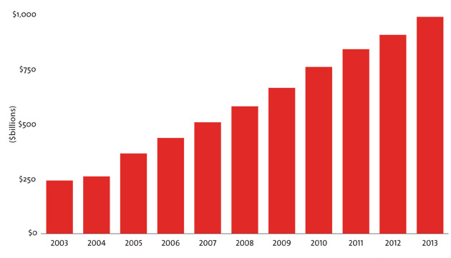
5. Value – The Value Gap.
Student loan debt has nearly quadrupled in the past 10 years.
Notes:
1. Source – Mother Jones, “The Student Debt Crisis in 9 Charts,” 2013.

Slide 14
6. Tuition – Differential equations and other challenges
Percentage of Four-Year Public Institutions with Differential Undergraduate Tuition in 2010-11
 | Doctoral | Master's | Bachelor's
Number of institutions | 172 | 271 | 120
% with any differential tuition | 42 | 18 | 30
% with differential tuition by college or major | 40 | 17 | 23
% with differential tuition by year enrolled | 10 | 4 | 23
Notes:
1. Source – Ehrenberg, Ronald G. “American Higher Education in Transition.” Journal of Economic Perspectives (26) 2012: 193-216

Slide 15
7. Competition – Not all competition is on the court or gridiron.
Competition for students is increasing.
Notes:
1. Source – National Association for College Admission Counseling. “2012 State of College Admissions.”

Slide 16
7. Competition – Not all competition is on the court or gridiron.
Institutions must also consider their global position.
Notes:
1. Source – Institute of International Education

Slide 17
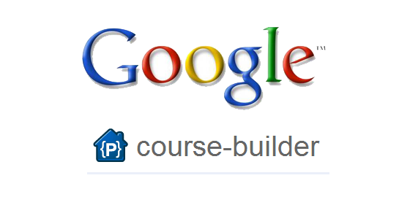
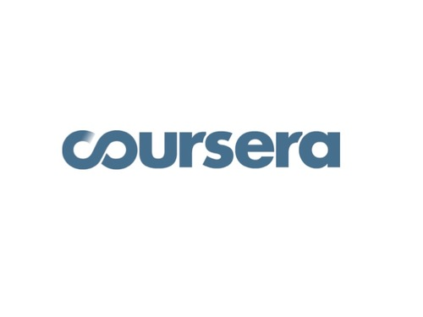
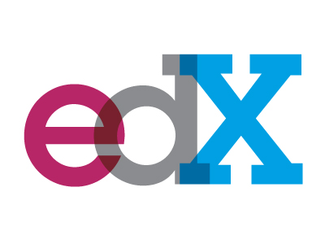
8. Technology – The point is MOOC – or is it?
MOOCs are an emerging use of technology but there are growing pains.

Slide 18
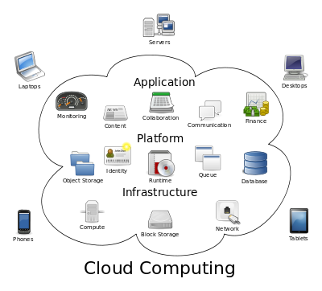
8. Technology – The point is MOOC – or is it?
It’s not all about MOOCs...

Slide 19
What did we learn?
Government funding sources are drying up.
Costs are increasing.
More non-tenured faculty to manage.
Enrollment is shifting.
Tuition is going up but not equally.
Questions about the value of college education.
Competition is heating up.
The pace of technology change is accelerating.

Slide 20
So now what?
Embrace change…
…appreciate the context (i.e., sense of urgency)
…create participatory processes
…understand strengths and weaknesses
Be unique…
…and set priorities
…build your brand as an institution
Innovate…
…in the classroom
…in student services
…in administration

Slide 21
Questions?
?

